Slide 1



Predict Customer Personality to boost marketing campaign by using Machine Learning
Created by:
Ferry Setefanus
ferrysetefanus@gmail.com
https://www.linkedin.com/in/ferry-setefanus-257098170/
Data Science enthusiast with a bachelor's degree in information systems at STMIK Pontianak. Passionate in data science, data analysis, machine learning and loves learning new things related to technology. Have experience in warehousing field for 4 years. Currently looking for an opportunity to work in the data field.

Slide 2
Overview
“A company can develop rapidly when it knows its customer personal behavior, so it can provide better services and benefits to customers who have the potential to become loyal customers. By processing historical marketing campaign data to improve performance and target the right customers so they can transact on the company's platform, from this data insight our focus is to create a cluster prediction model to make it easier for companies to make decisions.”

Slide 3
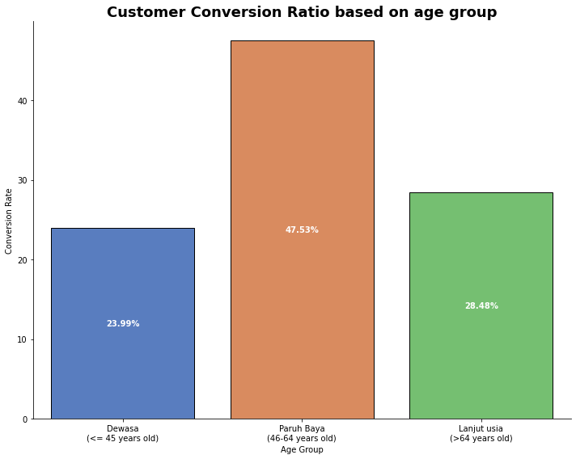
Conversion Rate Analysis Based on Income, Spending and Age
The distribution of the highest conversion rate is found in customers who are included in the middle-aged category. This means that middle-aged customers have a higher probability of taking actions that are profitable for our platform. We must retain customers who fall into this category, by providing specific advertisements and discounts for customers who are in this category.
For more details, see jupyter notebook here

Slide 4
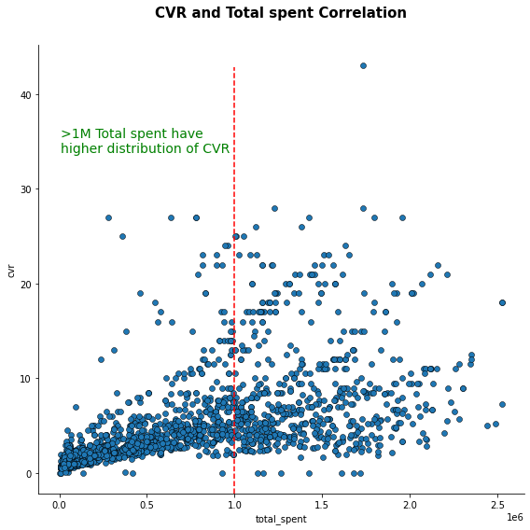
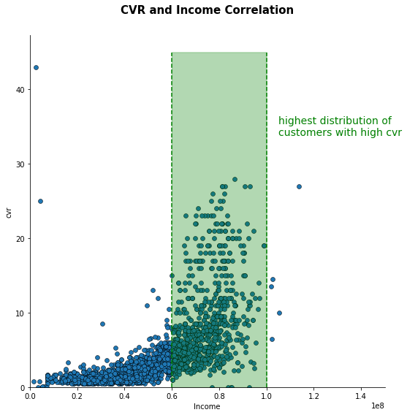
Conversion Rate Analysis Based on Income, Spending and Age
Customers who have higher income and total spending tend to have higher conversion rates. To increase the conversion rate, we can encourage customers to make higher spending by doing bundling promos in the form of flash sales periodically.
For more details, see jupyter notebook here

Slide 5
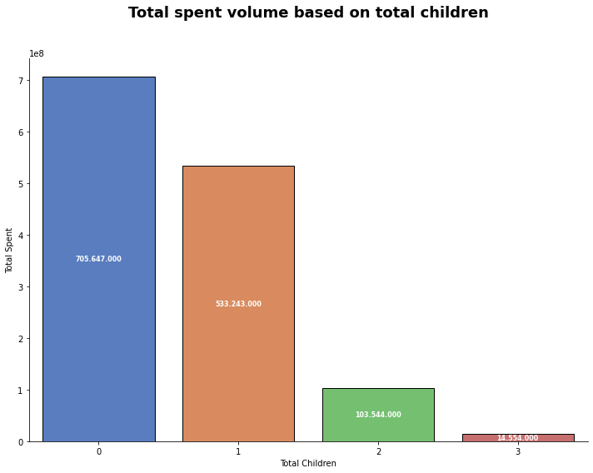
Conversion Rate Analysis Based on Income, Spending and Age
Customers with fewer children have a larger total spend on our platform compared to customers with more children. This is because there are fewer dependents in families with fewer children. To increase the total spend on our platform, we can provide specific ads and offers for families who have more than 1 child.
For more details, see jupyter notebook here

